Slide 1
Joint ESAs SFDR RTS
June 2021

Slide 2
SFDR - Introduction
Joint Committee of the European Supervisory Authorities
Regulation (EU) 2019/2088 on sustainability-related disclosures in the financial services sector (“SFDR”) sets out ESG disclosure requirements for a broad range of financial market participants, financial advisers and financial products supplementing existing rules.
EBA, EIOPA and ESMA (the ESAs) - through the Joint Committee - were empowered by the regulation to deliver a significant number of draft Regulatory Technical Standards (RTS).
In addition, Regulation (EU) 2020/852 (“Taxonomy Regulation”) added many new empowerments in the disclosure regulation, including on the do not significantly harm principle and on product-related taxonomy disclosures.
After a public consultation from April – September 2020, the ESAs’ Final Report and the draft RTS were published on 4 February 2021. A consultation on the taxonomy-related product disclosures was launched on 17 March 2021.

Slide 3
PAI disclosures according to ESAs’ RTS (Chapter II and Annex I RTS)
Joint Committee of the European Supervisory Authorities
The draft RTS includes a mandatory template, set out in Annex I, to use for the entity-level statement on considering principal adverse impacts of investment decisions on sustainability factors.
The disclosures are focused on a set of indicators for both climate and environment-related adverse impacts and adverse impacts in the field of social and employee matters, respect for human rights, anti-corruption and anti-bribery matters.
These indicators are divided into 18 universal mandatory indicators and 46 additional opt-in indicators for environmental and social factors, 2 of which must be selected as additional principal adverse impacts.
The draft RTS provides separate indicators for adverse impacts from investments in investee companies, sovereigns (and supranationals) and real estate assets.

Slide 4
RTS schedule for PAI disclosures
Joint Committee of the European Supervisory Authorities
The first statement under the RTS, from January 2022, should contain information not related to reference period (policies).
The first reference period (1 January 2022 – 31 December 2022) PAI data specified in Annex I of the RTS should be disclosed in 2023.
That second statement, due by 30 June 2023, should include 20 indicators, of which 18 are mandatory (table 1) and 2 additional (1 environmental and 1 social) must be selected from the remaining 46 social and environmental indicators in tables 2 and 3, plus any others that FMP deems material to their investment decisions.
By 30 June 2024 (the third statement), that FMP must also add a historical (year on year) comparison, comparing the first reference period where PAI data was applied (1 January 2022 – 31 December 2022) with the second reference period (1 January 2023 – 31 December 2023).

Slide 5
Pre-contractual product disclosure (Chapter III and Annex II-III RTS)
Joint Committee of the European Supervisory Authorities
The pre-contractual product disclosure has to take place through existing sectoral disclosure documents as listed in Article 6(3) SFDR according to the templates in Annex II-III RTS.
The following elements should be included in this disclosure:
The sustainable characteristics or sustainable investment objective of the product;
A description of the planned investment strategy;
The asset allocation planned for the product, including DNSH disclosures for sustainable investments;
A statement indicating whether the product considers PAI;
A reference to a website for more disclosure; and
Information for products designating an index as a reference benchmark on how the product is aligned with the benchmark and how the benchmark differs from a broad market index.
.

Slide 6
Public website product disclosures (Chapter IV RTS)
Joint Committee of the European Supervisory Authorities
Article 10 SFDR sets out provisions for product manufacturers of sustainable products to disclose on their website in greater detail how the products meet their characteristics or objectives. The disclosure has to start with a short summary.
The disclosure items should include many of the same disclosure items, in more detailed form, that are included in the pre-contractual disclosures. The Final Report also shifted the breakdown of direct and indirect investments to the website disclosures.
Website disclosure also includes requirements to disclose details on the methodology and data sources used and any limitations to the methodology or data sources.

Slide 7
Periodic product disclosure (Chapter V and Annex IV-V RTS)
Joint Committee of the European Supervisory Authorities
Periodic product disclosure requirements are intended to show the track record of the product in terms of how successful it is in attaining its sustainable characteristics or objectives.
The disclosure has to take place through existing periodic disclosure sectoral disclosure documents as listed in Article 11(2) SFDR according to the templates in Annex IV-V RTS.
The RTS requires the following items to be disclosed:
To what extent the sustainable characteristics or objectives have been met;
The top 15 holdings of the product;
The proportion of sustainability-related investments including DNSH disclosures for sustainable investments;
Actions taken to attain the sustainable characteristics and objectives; and
For products designating an index as a reference benchmark, the sustainable performance of that index.

Slide 8
Consultation paper on taxonomy-related product disclosures
Joint Committee of the European Supervisory Authorities
Regulation (EU) 2020/852 (Taxonomy Regulation, “TR”) added new empowerments for the ESAs on product-related environmental taxonomy disclosures by amending Regulation (EU) 2019/2088 (Sustainable Finance Disclosure Regulation, “SFDR”)
The Taxonomy Regulation places new disclosure obligations on financial market participants making available products making sustainable investments with environmental objectives about their taxonomy-related investments
The product-related empowerments cover specific taxonomy-related information in financial products’ pre-contractual and periodic disclosures:
  The disclosures required by these empowerments require identification of the environmental taxonomy objectives of the product
  The disclosures also require an explanation of how and to what extent the activities invested in are aligned with the taxonomy

Slide 9
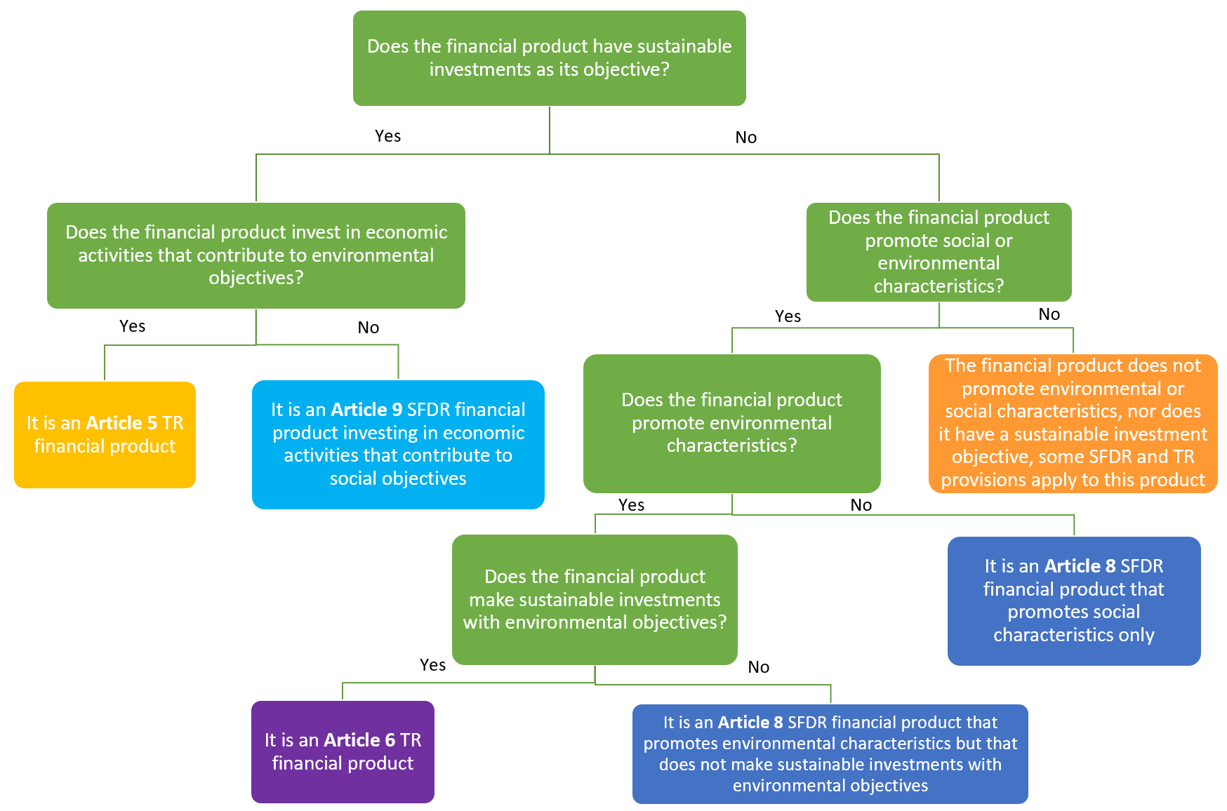
Article 5 – 6 TR financial products

Slide 10
Single rulebook for sustainable product disclosures
Joint Committee of the European Supervisory Authorities
The ESAs saw merit in creating a “single rulebook” for sustainability product disclosures under the SFDR and TR. The aim of the draft RTS in the consultation paper is to allow a common set of requirements for all sustainability related products in scope of SFDR and TR.
To achieve this the draft RTS in the consultation paper:
    amends the SFDR RTS published by the ESAs on 4 February 2021;
    makes specific disclosure requirements for the subset of products that make sustainable investments with environmental objectives according to the EU taxonomy within the broader set of SFDR RTS sustainability disclosures; and
    amends the existing SFDR RTS templates for pre-contractual and periodic templates to provide new sections for the relevant subset of products.

Slide 11
“How and to what extent”: KPI and statement of taxonomy alignment
Joint Committee of the European Supervisory Authorities
The disclosures should include information on “how and to what extent” the economic activities the product invests in, qualify as environmentally sustainable
The consultation paper proposes a graphical representation of the taxonomy-aligned investments of the product calculated based on a key performance indicator (KPI)
The KPI is aligned with the ESAs technical advice on Article 8 TR disclosures – the calculation is based on a weighted average of taxonomy-compliant activities that the investments of the financial product funds
Also, the disclosures include a requirement to certify through a statement that the activities funded by the product are aligned with the criteria of Article 3 of the TR
The DNSH certification for the subset of taxonomy products would replace the broader 2(17) SFDR DNSH in the SFDR RTS by way of derogation

Slide 12
Next steps
Joint Committee of the European Supervisory Authorities
The Commission is expected to adopt the 4 February 2021 RTS in June 2021, which will trigger a 3-month period for EP and Council to register objection.
The ESAs sent a letter to the Commission on 7 January 2021 requesting clarity on priority issues in SFDR: application to AIFMs, the 500-employee threshold for PAI statements, the scope of Article 8-9 financial products and application to portfolios and dedicated funds. The Commission responses is expected imminently.
The ESAs published on 25 February supervisory statement to achieve an effective and consistent application and national supervision of the SFDR during the interim period between the application of SFDR (10 March 2021) and the RTS (1 January 2022). The statement clarifies that the draft RTS can be used as a reference during the interim period.
The ESAs aim to produce a final report with final draft RTS on the taxonomy-related product disclosures in late June or early July 2021

